Slide 1

Budget Sales Analytics

Slide 2
INTRODUCTION
▶ Analyzing budget sales data has played a crucial role in demonstrating the value of effective budgeting and resource allocation. This project emphasizes the significance of optimizing marketing expenditures to enhance ROI, showcasing how data-driven decision-making is essential for a successful business strategy.

Slide 3
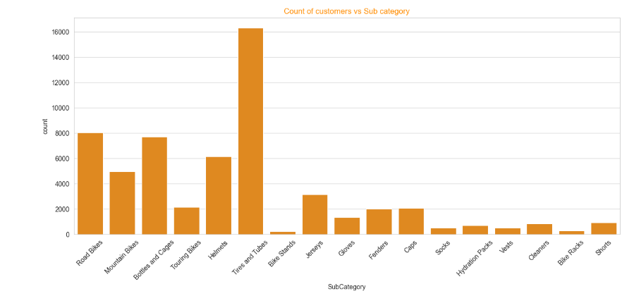
Most of the customers are interested in buying accessories like bottles, cages, tires, tubes. Within the bike category segment, road and mountain bikes are more sold.

Slide 4
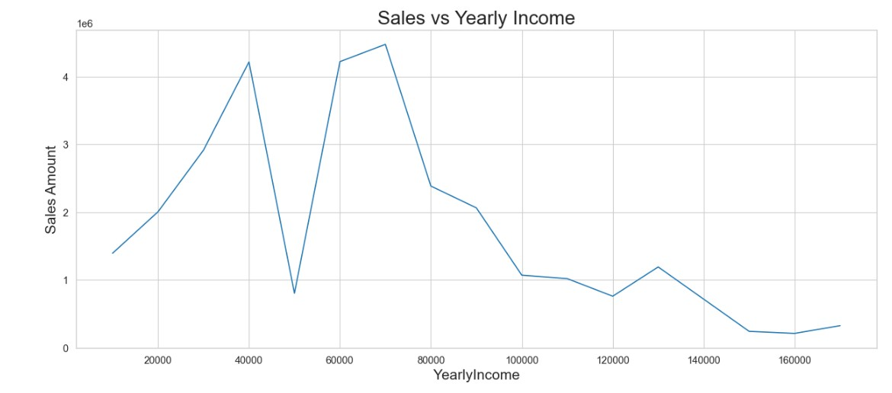
Most of the sales comes from middle class people with yearly income from 30,000 to 70,000 Dollars.

Slide 5
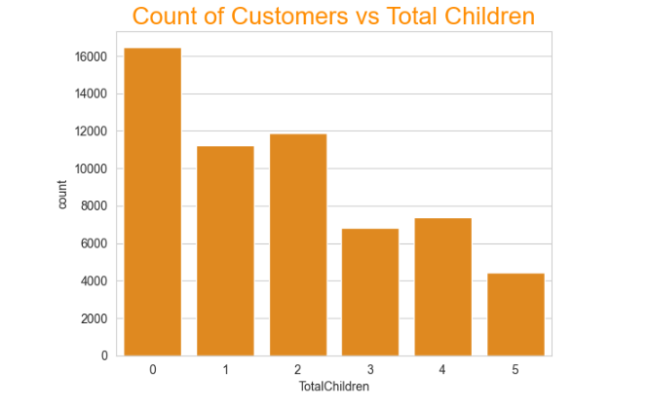
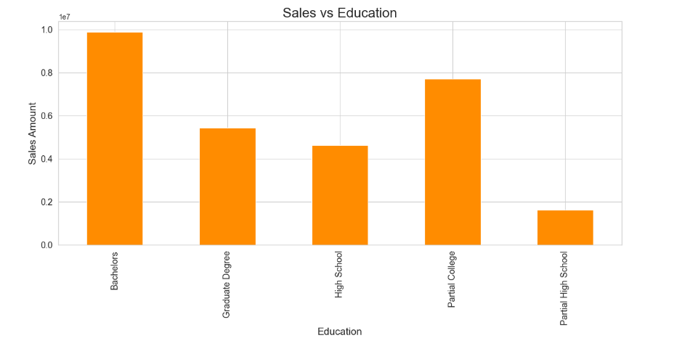
Customers with more than 2 children are very less as compared to the customers with children less than 3.
Most of the customers are graduates or have Partial College education.

Slide 6
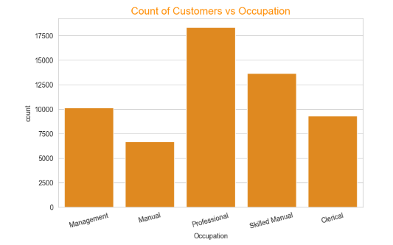
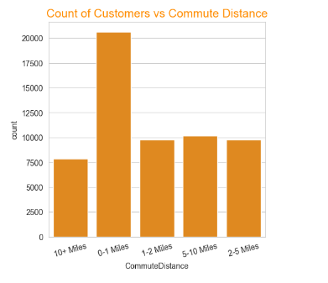
Most of the customers are Professional, Skilled Manual and Management occupation.
Most of the customers are those who has less commute distance 0-1 miles. Other customers who has commute distance between 1 to 10, has nearly have same customers count.

Slide 7
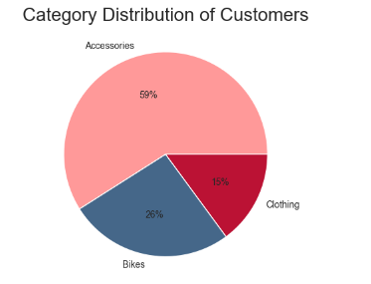
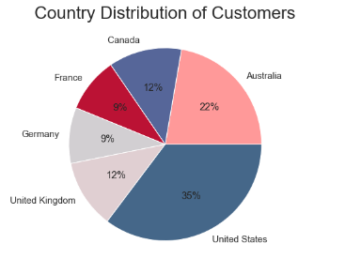
Most of the customers are buying Accessories.
More than of 50% customers are from United States and Australia.

Slide 8
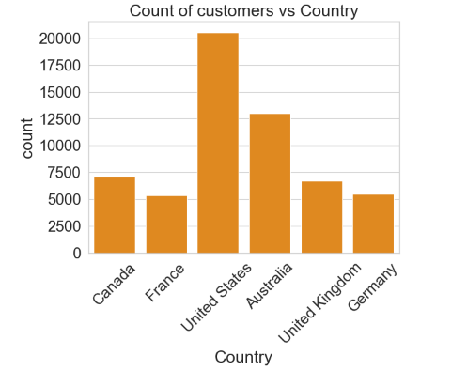
Most of customers are from United States

Slide 9
THANK YOU

